Slide 1
Outline:
Introduction
Link Description
Link-Connection Description
Convention for Affixing Frames to Links
Manipulator Kinematics
Actuator Space, Joint Space, and Cartesian Space
Example: Kinematics of PUMA Robot

Slide 2
Introduction:
Kinematics:
Motion without regarding the forces that cause it (Position, Velocity, and Acceleration). Geometry and Time dependent.
Rigid links are assumed, connected with joints that are instrumented with sensors to the measure the relative position of the connected links.
Revolute Joint Joint Angle
Prismatic Joint Joint Offset/Displacement
Degrees of Freedom
# of independent position variables which have to be specified in order to locate all parts of the mechanism
Sensor
Sensor

Slide 3
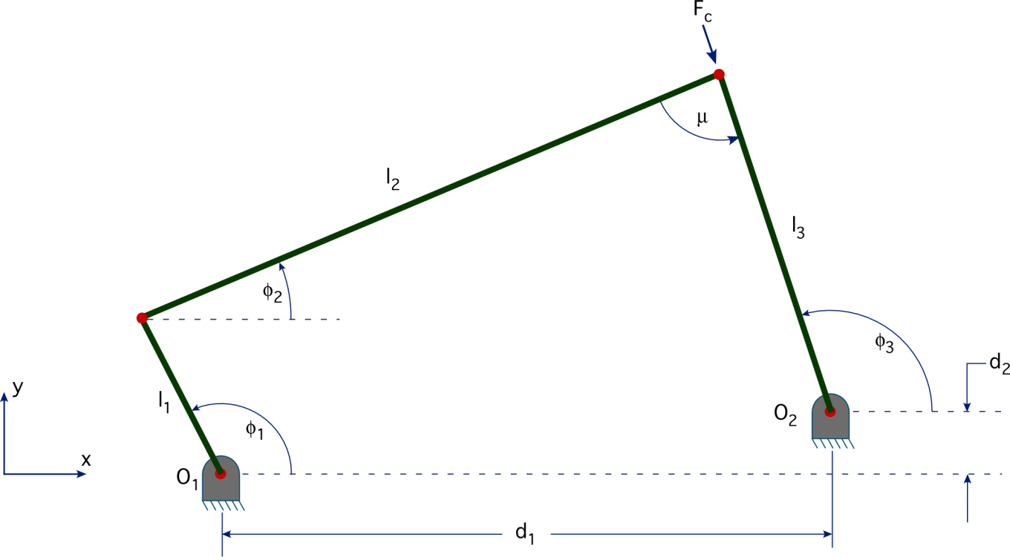
Introduction:
Degrees of Freedom
Ex: 4-Bar mechanism,
# of independent position
variables = 1
➔ DoF = 1
Typical industrial open chain serial robot
1 Joint ➔ 1 DoF
➔ # of Joints ≡ # of DoF
End Effector:
Gripper, Welding torch, Electromagnetic, etc…

Slide 4
Introduction:
The position of the manipulator is described by giving a description of the tool frame (attached to the E.E.) relative to the base frame (non-moving).
Froward kinematics:
Given
Joint Angles
Calculate
Position & Orientation of the tool frame w. r. t. base frame
Joint space
(θ₁,θ₁,…,θ_{DoF})
Cartesian space
(x,y,z, and orientation angles)

Slide 5
Link Description:
In this chapter:
Rigid links are assumed which define the relationship between the corresponding joint axes of the manipulator.
Links Numbering:
E.E.
n-1
n
2
1
0
Base

Slide 6
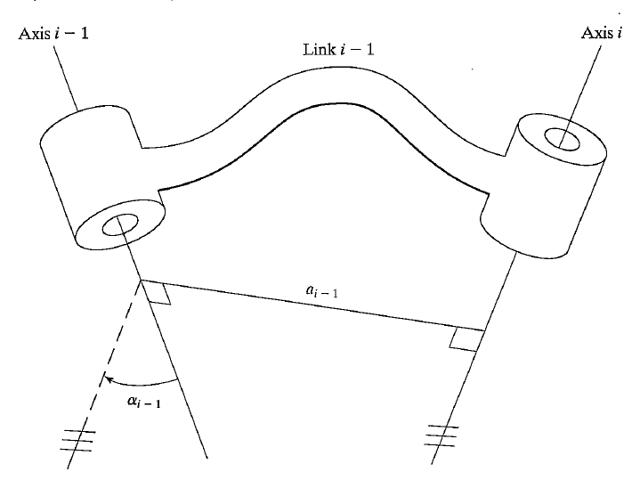
Link Description:
Joint axis (i):
Is a line in space or direction vector about which link (i) rotates relative to link (i-1)
a_{i} ≡ represents the distance between axes (i & i+1) which is a property of the link (link geometry)
a_{i} ≡ i^{th} link length
α_{i} ≡ angle from axis i to i+1 in right hand sense about a_{i}.
α_{i} ≡ link twist
Note that a plane normal to a_{i} axis will be parallel to both
axis i and axis i+1.

Slide 7
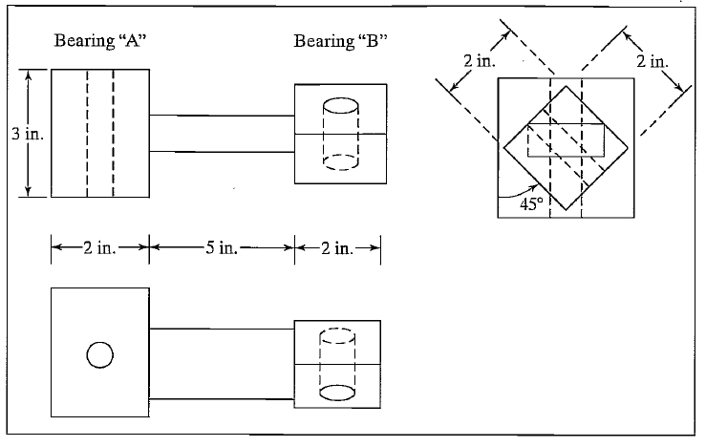
Link Description
Example: consider the link, find link length and twist?
a = 7in
α = +45º

Slide 8
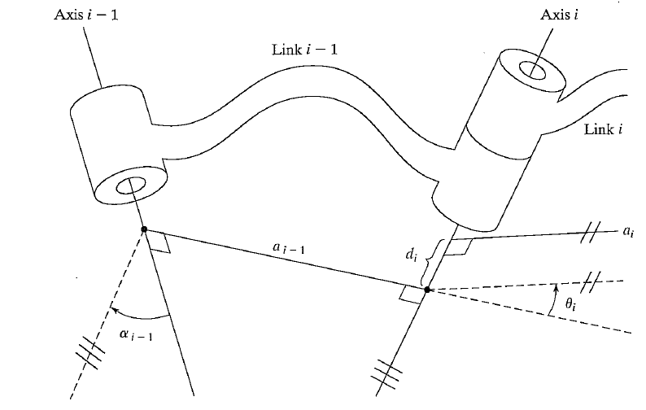
Joint Description
Intermediate link:
Axis i ≡ common axis between links i and i-1
d_{i} ≡ link offset ≡ distance along this
common axis from
one link to the next
θ_{i} ≡ joint angle ≡ the amount
of rotation about this
common axis between
one link and the other
Important
d_{i} ≡ variable if joint i is prismatic
θ_{i} ≡ variable if joint i is revolute

Slide 9
Joint Description
First and last links:
Use a₀ = 0 and α₀ = 0. And a_{n} and α_{n} are not needed to be defined
Joints 1:
Revolute ➔ the zero position for θ₁ is chosen arbitrarily.
➔ d₁ = 0.
Prismatic ➔ the zero position for d₁ is chosen arbitrarily.
➔ θ₁ = 0.
Joints n: the same convention as joint 1.
Zero values were assigned so that later calculations will be as
simple as possible

Slide 10
Joint Description
Link parameters
Hence, any robot can be described kinematically by giving the values of four quantities for each link. Two describe the link itself, and two describe the link's connection to a neighboring link. In the usual case of a revolute joint, θ_{i} is called the joint variable, and the other three quantities would be fixed link parameters. For prismatic joints, d₁ is the joint variable, and the other three quantities are fixed link parameters. The definition of mechanisms by means of these quantities is a convention usually called the Denavit—Hartenberg notation

Slide 11
Convention for attaching frames to links
A frame is attached rigidly to each link; frame {i} is attached rigidly to link (i), such that:
Intermediate link
${\hat{Z}}_{i}$-axis of frame {i} is coincident with the joint axis (i).
The origin of frame {i} is located where the a_{i} perpendicular intersects the joint (i) axis.
${\hat{X}}_{i}$ -axis points along a_{i} in the direction from joint (i) to joint (i+1)
In the case of a_{i} = 0, ${\hat{X}}_{i}$ is normal to the plane of ${\hat{Z}}_{i}$ and ${\hat{Z}}_{i+1}$. We define α _{i} as being measured in the right-hand sense about ${\hat{X}}_{i}$.
${\hat{Y}}_{i}$ is formed by the right-hand rule to complete the i^{th} frame.

Slide 12
Convention for attaching frames to links
First link/joint:
Use frames {0} and {1} coincident when joint variable (1) is zero.
➔ (a₀ = 0, α₀ = 0, and d₀ = 0) if joint (1) is revolute
➔ (a₀ = 0, α₀ = 0, and d₀ = 0) if joint (1) is revolute
Last link/joint:
Revolute joint: frames {n-1} and {n} are coincident when θ_{i} = 0.
as a result d_{i} = 0 (always).
Prismatic joint: frames {n-1} and {n} are coincident when d_{i} = 0.
as a result θ_{i} = 0 (always).

Slide 13
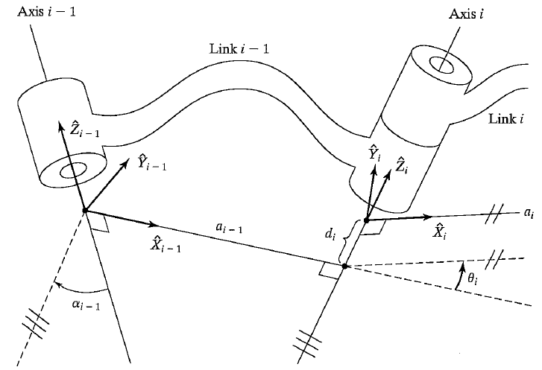
Convention for attaching frames to links
Summary
Note: frames attachments
is not unique

Slide 14
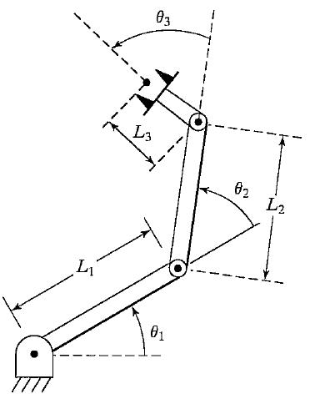
Convention for attaching frames to links
Example: attach frames for the following manipulator, and find DH parameters…

Slide 15
Convention for attaching frames to links
Example: attach frames for the following manipulator, and find DH parameters…
Determine Joint axes ${\hat{Z}}_{i}$
(in this case out of the page)
➔ All α_{i} = 0
Base frame {0} when θ₁ = 0
➔ ${\hat{X}}_{0}$ can be determined.
Frame {3} (last link) when θ₃ = 0
➔ ${\hat{X}}_{3}$ can be determined.

Slide 16
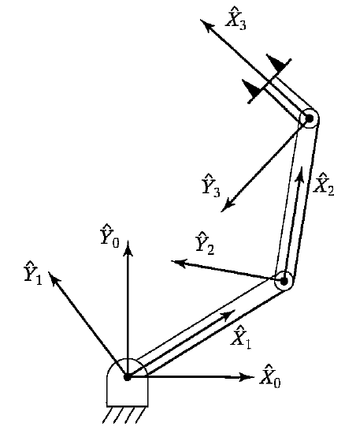
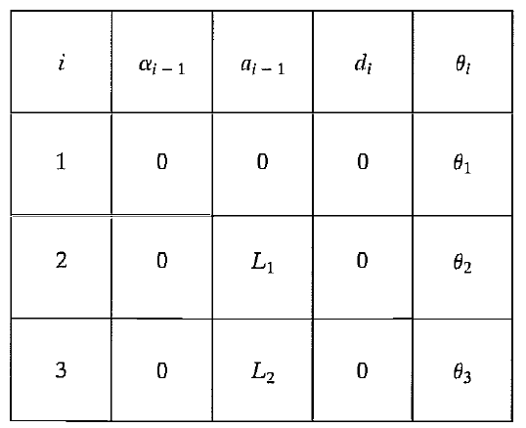
Convention for attaching frames to links
Construct the table:

Slide 17
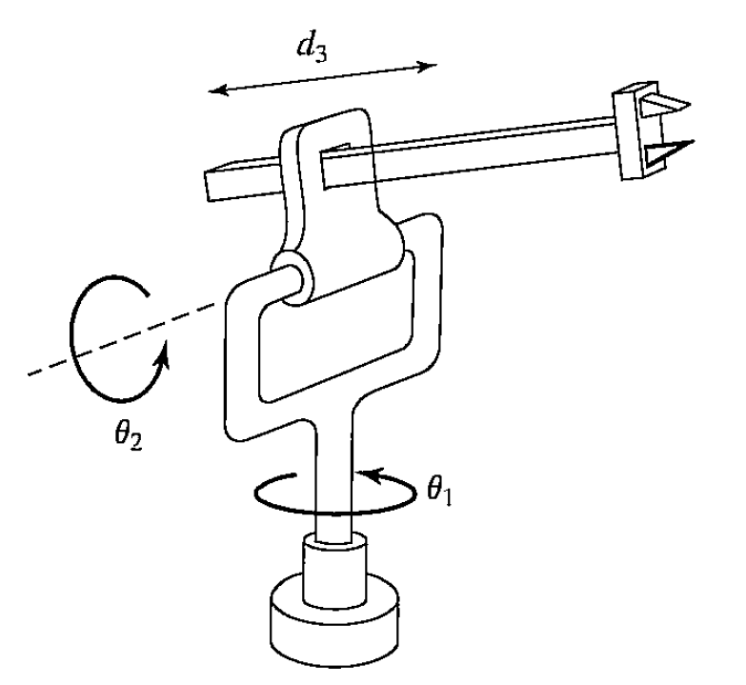
Convention for attaching frames to links
Previous exam question
For the 3DoF manipulator shown in the figure assign frames for each link using DH method and determine link parameters.

Slide 18
Convention for attaching frames to links
Joint axes ➔ $\hat{Z}$- directions

Slide 19
Convention for attaching frames to links
$\hat{X}$- directions

Slide 20
Convention for attaching frames to links
Origens

Slide 21
Convention for attaching frames to links
$\hat{Y}$- directions

Slide 22
Convention for attaching frames to links
DH parameters…

Slide 23
Convention for attaching frames to links
DH parameters…
i | a_{i-1} | α_{i-1} | θ_{i} | d_{i}
1 | 0 | 0 | θ₁ | 0
2 | 0 | 90 | θ₂ | 0
3 | a₂= Const. | 90 | 0 | d₃

Slide 24
Manipulator Kinematics
Extract the relation between frames on the same link
➔ position & orientation of {n} relative to {0}
POSITION:

Slide 25
Manipulator Kinematics
ORIENTATION:
Rotation about moving axes:
Originally {i-1} and {i} have the same orientation
1st rotation: rotation about ${\hat{X}}_{i−1}$ by an angle α_{i-1}.
2nd rotation: rotation about ${\hat{Z}}_{i}$ by an angle θ_{i}

Slide 26
Manipulator Kinematics
ORIENTATION:
TRANSFORMATION MATRIX:

Slide 27
Manipulator kinematics
Example: for the previous manipulator find the transformation matrix for each link.
i | a_{i-1} | α_{i-1} | θ_{i} | d_{i}
1 | 0 | 0 | θ₁ | 0
2 | 0 | 90 | θ₂ | 0
3 | a₂ | 90 | 0 | d₃
Each matrix is
constructed from
one row of the table

Slide 28
Manipulator kinematics
Example: for the previous manipulator find the transformation matrix for each link.
i | a_{i-1} | α_{i-1} | θ_{i} | d_{i}
1 | 0 | 0 | θ₁ | 0
2 | 0 | 90 | θ₂ | 0
3 | a₂ | 90 | 0 | d₃

Slide 29
Manipulator kinematics
Concatenating link transformations:
Each transformation has one variable (θ_{i} or d_{i})
➔ is a function of all n-joint variables

Slide 30
Manipulator kinematics
Concatenating link transformations:
Each transformation has one variable (θ_{i} or d_{i})
➔ is a function of all n-joint variables

Slide 31
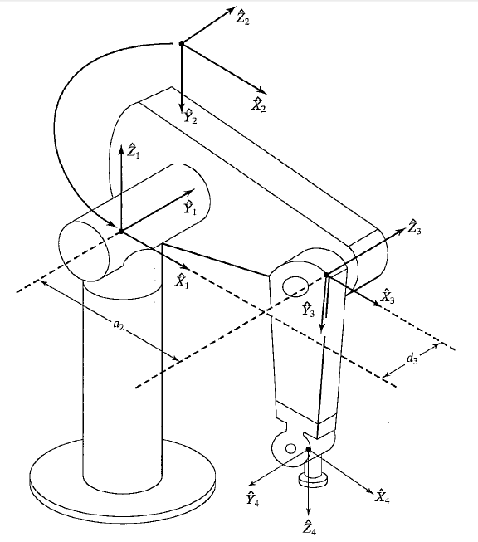
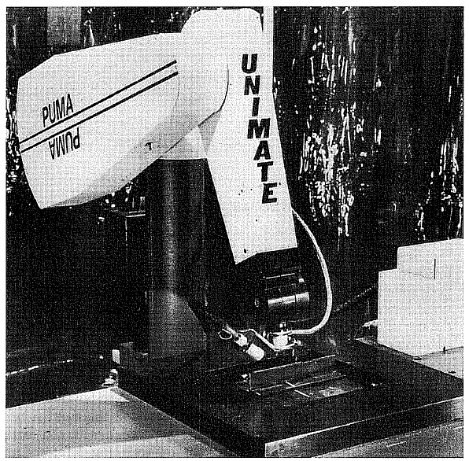
Example: Kinematics of PUMA Robot

Slide 32
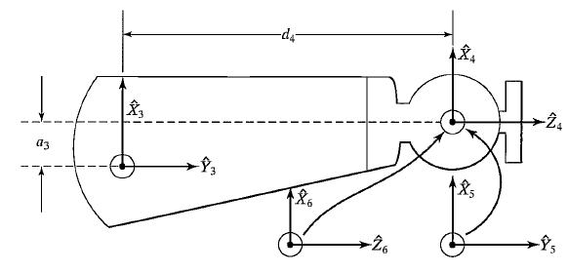
Example: Kinematics of PUMA Robot
Frame attachments

Slide 33
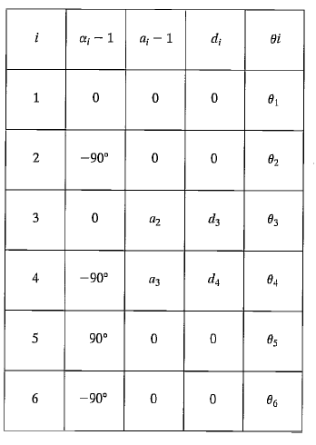
Example: Kinematics of PUMA Robot
DH parameters

Slide 34
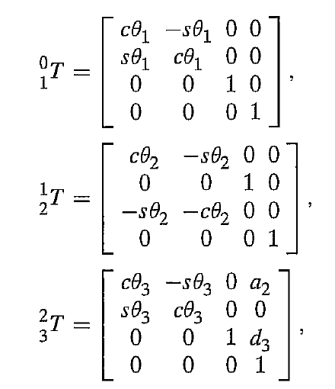
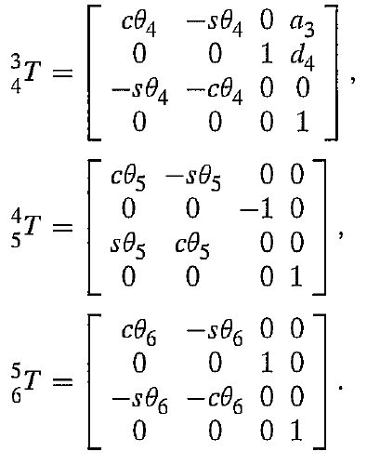
Example: Kinematics of PUMA Robot
Transformation matrices
Refer to the book for more kinematic equations

Slide 35
Actuator, Joint, and Cartesian Spaces:
Joint Space: Joint variables (θ₁/d₁, θ₂/d₂, … θ_{n}/d_{n})
Cartesian Space: Position and orientation of the E.E. relative to the base frame
Direct kinematics: joint variables ➔ Position and orientation of the E.E. relative to the base frame.
Actuator Space: In most of cases, actuators are not connected directly to the joints (Gear trains, mechanisms, pulleys and chains …). Moreover, sensors/encoders are mounted on the actuators rather than robot joints. Hence, it will be easier to describe the motion of the robot by actuator variables.

Slide 36
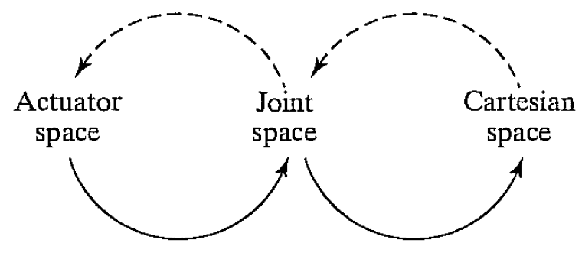
Actuator, Joint, and Cartesian Spaces:
Inverse
Problem
Inverse
Problem
Direct
Problem
Direct
Problem

Slide 37
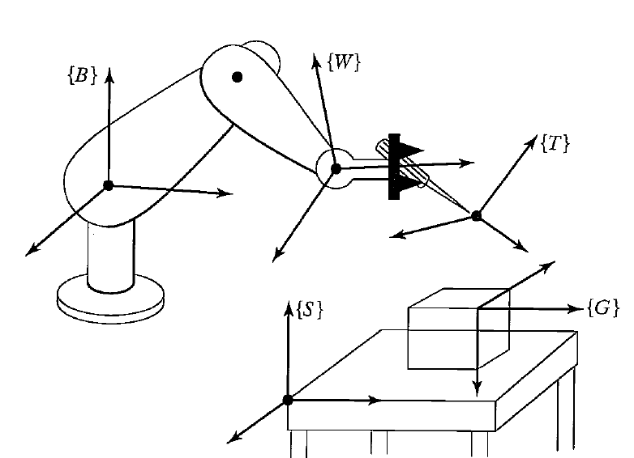
Frames with standard names:

